Slide 1
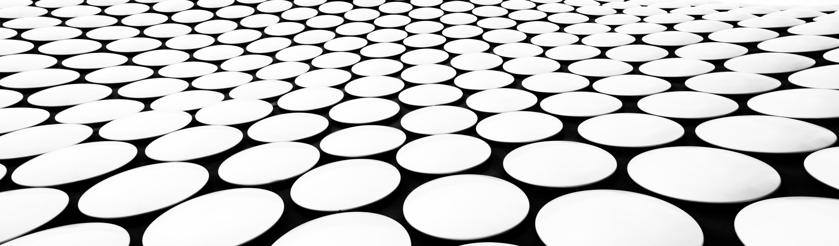
DTSA 5511 Final Project Identifying Different Pistachio Species
Nathan Hansen

Slide 2


Introduction
For my final project I have chosen to tackle an image classification problem presented by a Kaggle dataset
The images in the dataset are of two different species of pistachios: "Siirt" and "Kirmizi“
The goal is to create a neural-network based model capable of reliably classifying each image by species
Steps include:
Data exploration
Data augmentation
Model architecture definition
Model training with hyperparameter exploration
Review results

Slide 3
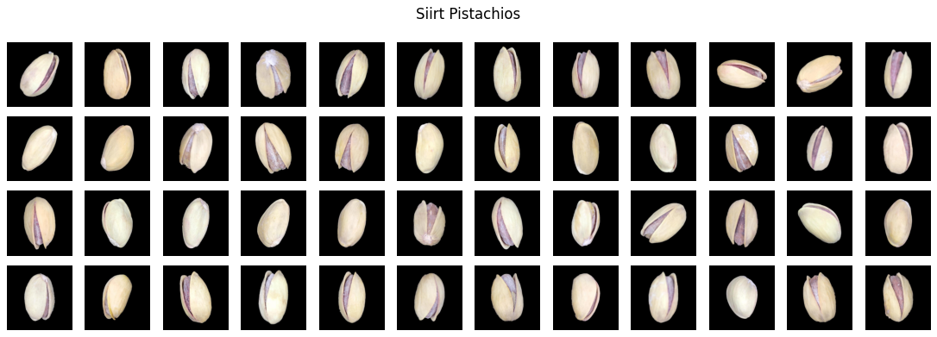
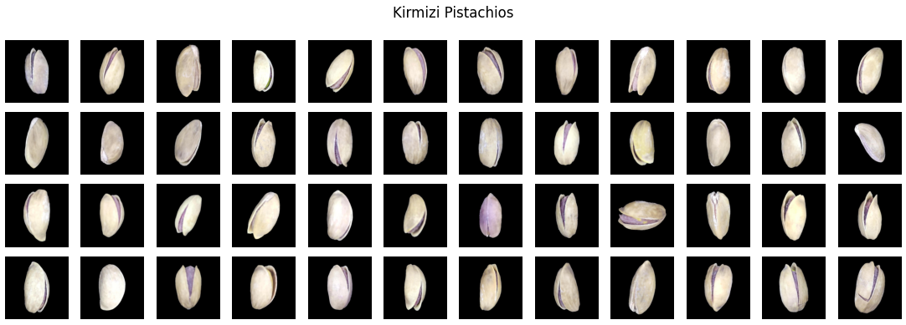
Exploratory Data Analysis
Initial observations of datasets:
Images are 600x600 pixels in .jpg format
Three color channels (RGB)
916 Siirt examples
1232 Kirmizi examples
Very similar in appearance, both size/shape and color
Photos taken at various pistachio orientations
High contrast with dark background
No obvious cleaning required

Slide 4
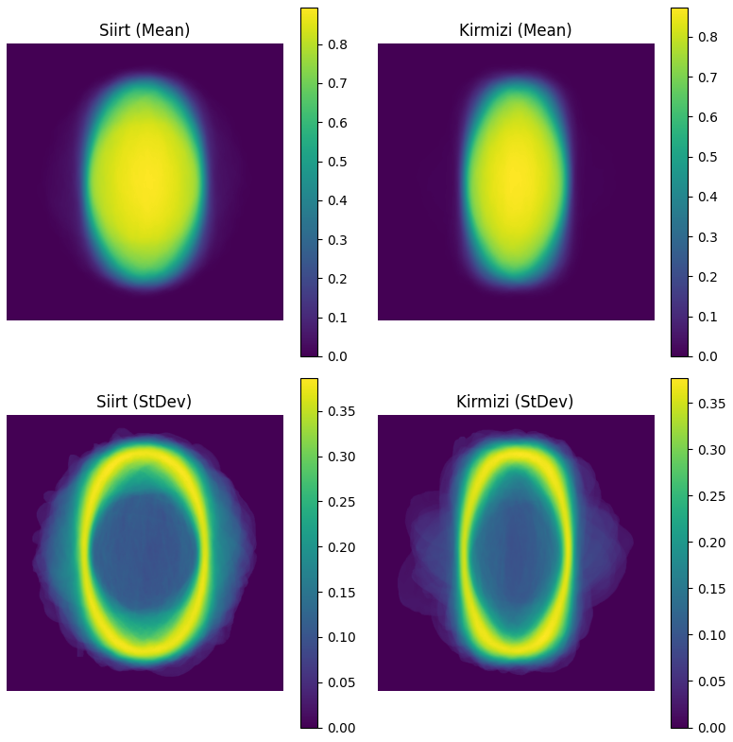
Exploratory Data Analysis (cont.)
Observations from taking the mean and standard deviation of each pixel across the datasets:
Most images are oriented “upright”
Siirt may have more orientation variations than Kirmizi
Siirt may be wider on average than Kirmizi
(Assuming uniform camera setup and lighting between each image)

Slide 5
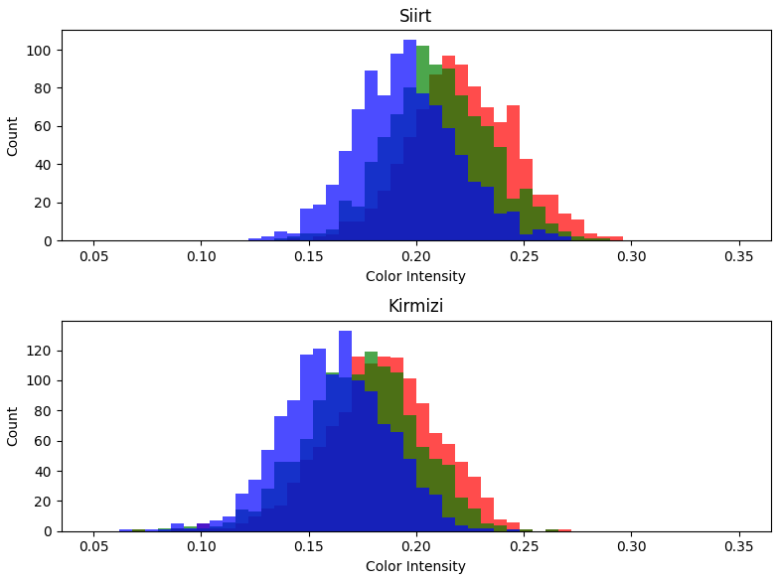
Exploratory Data Analysis (cont.)
Histograms of the average color intensity per channel provide additional insights:
Similar distribution shape
Reflects their subjectively similar colors
Kirmizi shifted lower than Siirt
May reflect Kirmizi being smaller than Siirt on average (rotation independent), or simply darker

Slide 6
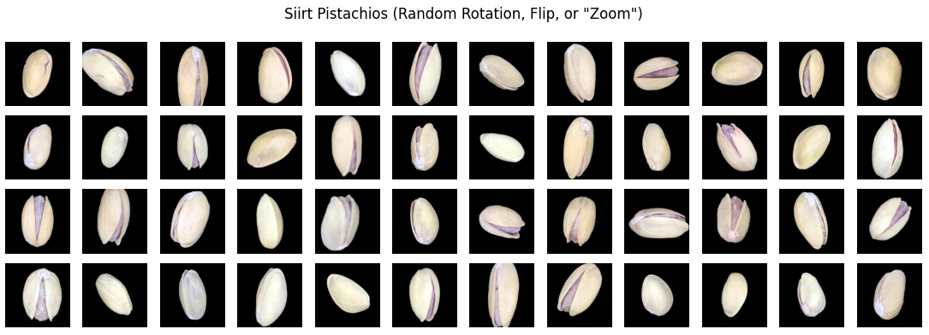
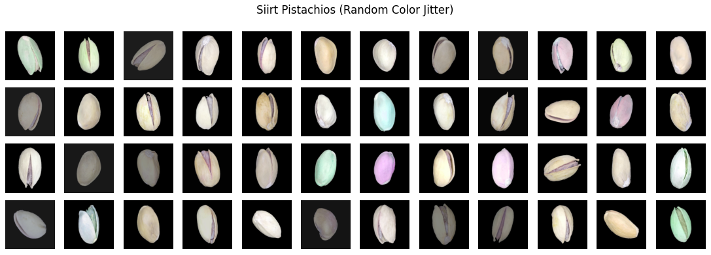
Data Augmentations
The number of training images can be increased through augmentations
Random rotations and flips may encourage orientation-agnostic feature extraction
“Zoom” (resize and crop) can help address size and placement variations between pistachios
Color augmentations may encourage pattern extraction over absolute values and account for differences in lighting
Augmentations will be evaluated separately

Slide 7
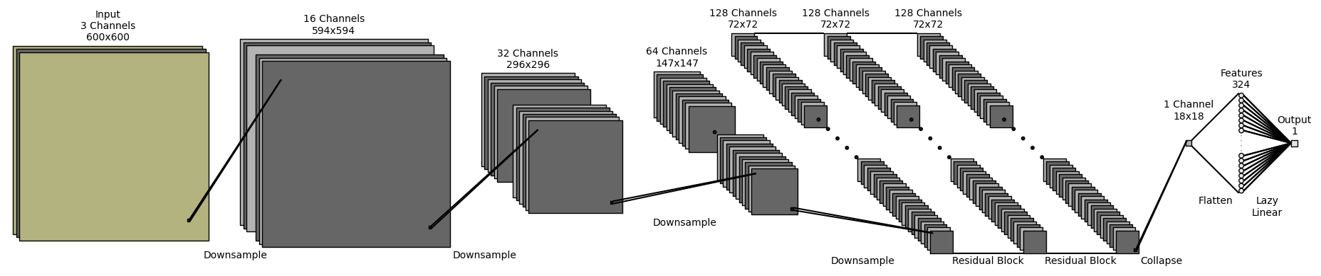
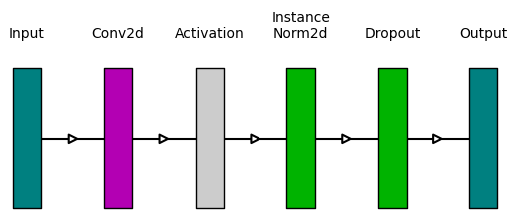
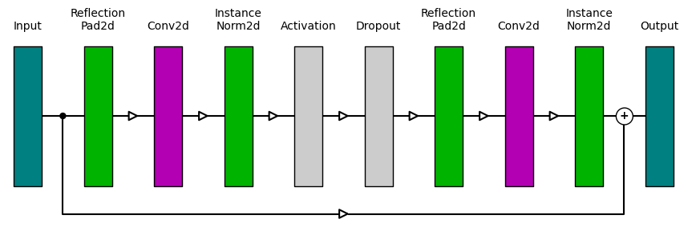
Model Architecture
https://github.com/nhansendev/PyDrawNet
Based on the NLayerDiscriminator implementation from the authors of CycleGAN [1]
Downsampling extracts a compact, latent encoding of features
Residual Blocks add depth for more complex feature extraction
Outputs a classification from 0 to 1 (Siirt or Kirmizi)
1. junyanz/pytorch-CycleGAN-and-pix2pix: Image-to-Image Translation in PyTorch. (n.d.). https://github.com/junyanz/pytorch-CycleGAN-and-pix2pix/tree/master

Slide 8
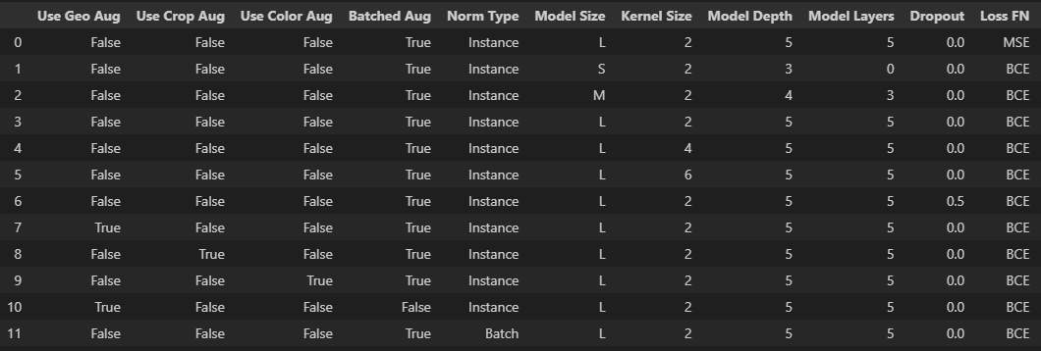
Hyperparameter Variations
Varying the size of the model through the number of convolution blocks and residual blocks
Varying the size of the kernel used in the convolutions
Adding dropout for additional regularization
The three groups of augmentation types
Applying the same augmentation across a batch of images, or a random augmentation to each image in the batch
Instance normalization vs Batch normalization
Binary Cross Entropy (BCE) loss vs Mean Squared Error (MSE) loss

Slide 9
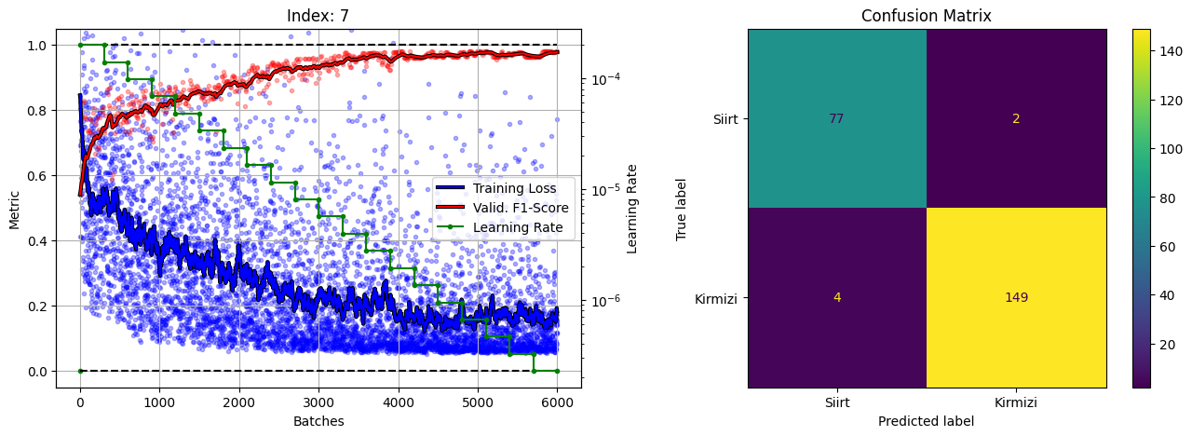
Results
Final validation F1-Score of 0.98
Used exponential learning rate decay
Noisy training loss suggests the presence of a small number of difficult to learn images

Slide 10
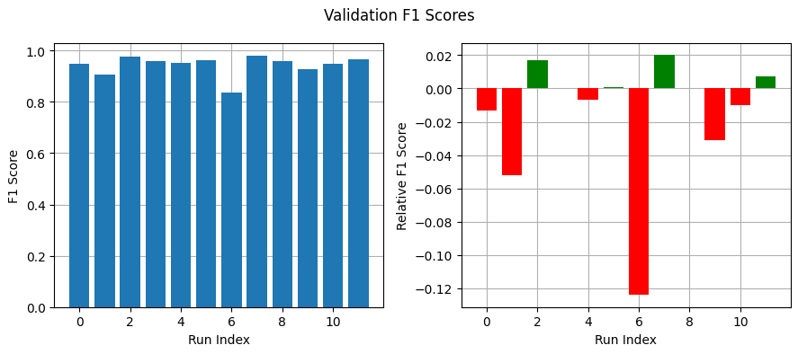
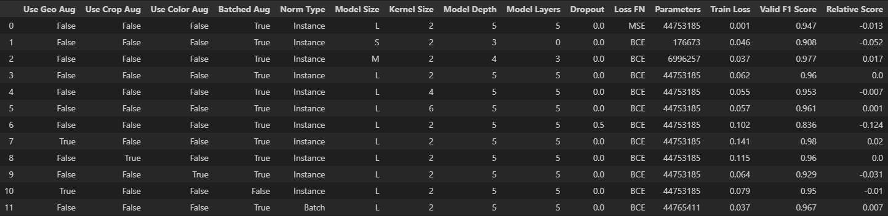
Results (CONT.)
Baseline Large model as reference (#3)
Large model with geo. augments performed best (#7)
Medium model performed well (#2) – Large might be over-fitting
Dropout very detrimental (#6)
Batch normalization may be beneficial (#11)
Only geo. augmentations showed improvements
Reference Run

Slide 11
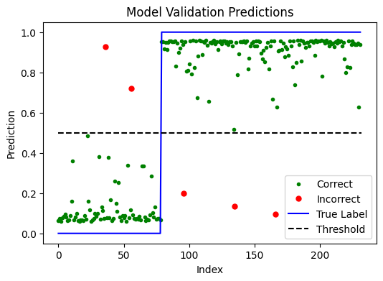
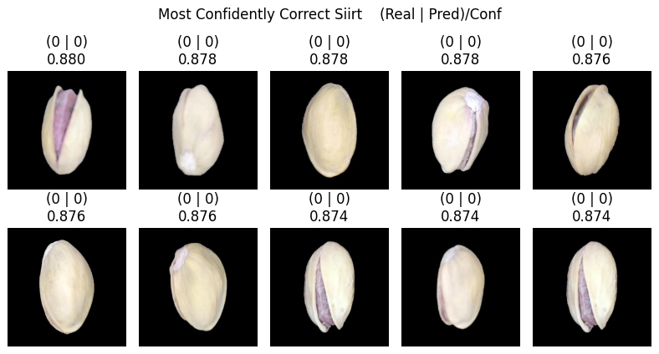
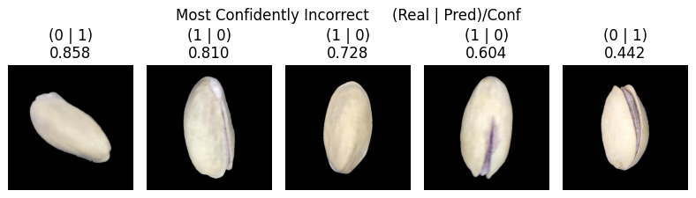
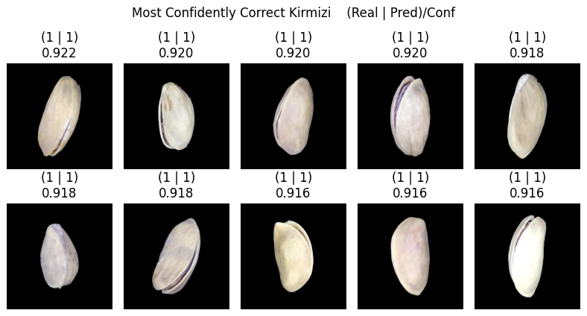
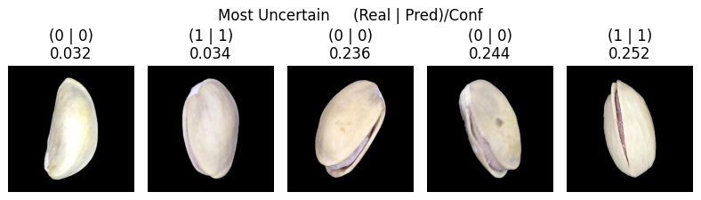
Model Exploration
Labels
Siirt: 0
Kirmizi: 1

Slide 12
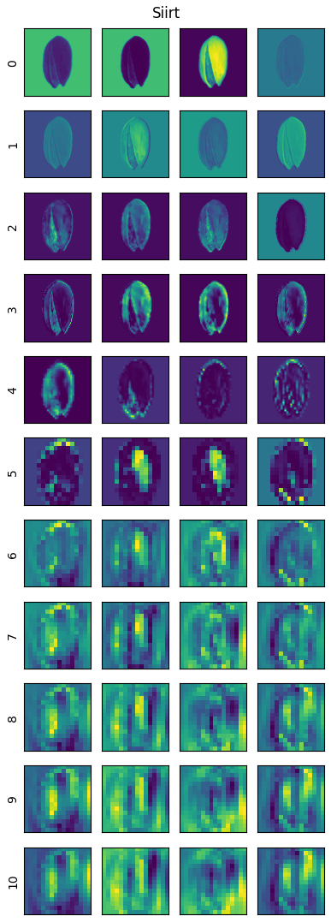
Model Exploration (CONT.)
Residual Blocks
Downsample

Slide 13
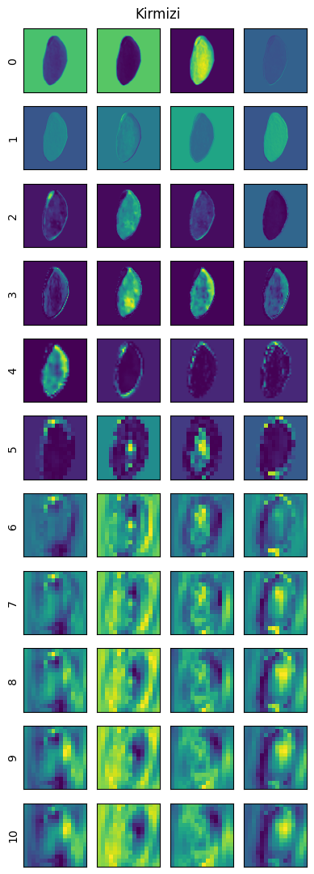
Model Exploration (CONT.)
Residual Blocks
Downsample

Slide 14
Conclusion
The goal of the project was to create neural-network based models capable of reliably categorizing images of different pistachio species
The chosen model was based on the same discriminator structure used in CycleGANs
After testing various hyperparameters a model with a F1-score of 0.98 on the validation data was trained
One key characteristic seems to be that Siirt pistachios are wider or rounder than Kirmizi, which the model also learned
Future areas of exploration could include:
Model ensembles
Pre-trained vision models for feature encoding
Additional hyperparameter combinations
All code for this project can be found on my GitHub: github.com/nhansendev/DTSA_5511_FinalProject

